Slide 1




Group-4 Capstone Project ShopForHome
Mentor – Mr. KiranKumar Kurra
Team -
Aman Raj
Rajat Kumar
Sristy Kedia
Chinmoy Manna
Rudranarayan Dhal
SANTOSH KUMAR MARPINA

Slide 2
Introduction
ShopForHome is a popular Store in the market for shopping the home décor stuff. Due to Covid 19 all the offline shopping stopped. So, the store wants to move to the online platforms and wants their own web application.
There are 2 users on the application: -
1.User
2.Admin
It has mainly four categories of products :-
a)Furniture
b)Kitchen
c)Paintings
d)Showpieces

Slide 3
Features
User Stories –
As a user I should be able to login, Logout and Register into the application.
As a user I should be able to see the products in different categories.
As a user I should be able to sort the products.
As a user I should be able to add the products into the shopping cart.
As a user I should be able to increase or decrease the quantity added in the cart.
As a user I should be able to add “n” number of products in the cart.
As a user I should be able to get the Wishlist option where I can add those products which I want but don’t want to order now.
As a user I should get different discount coupons.

Slide 4
Admin Stories –
1. As an Admin I should be able to login, Logout and Register into the application.
2. As an Admin I should be able to perform CRUD on Users.
3. As an Admin I should be able to Perform CRUD on the products.
4. As an Admin I should be able to get bulk upload option to upload a csv for products details
5. As an Admin I should be able to get the stocks.
6. As an Admin I should be able to mail if any stock is less than 10.
7. As an Admin I should be able to get the sales report of a specific duration.
8. As an Admin I should be able to set the discount coupons for the specific set of users

Slide 5
Technologies Used –
Frontend –
AngularJS
Material UI (Sweetaleat2, MatCard, MatTable etc.)
HTML,CSS
Bootstrap Grid
Font Awesome Icons
Backend –
Java
SpringBoot
Data JPA
Microservices
Security –
JWT Authentication
Database –
Mysql

Slide 6
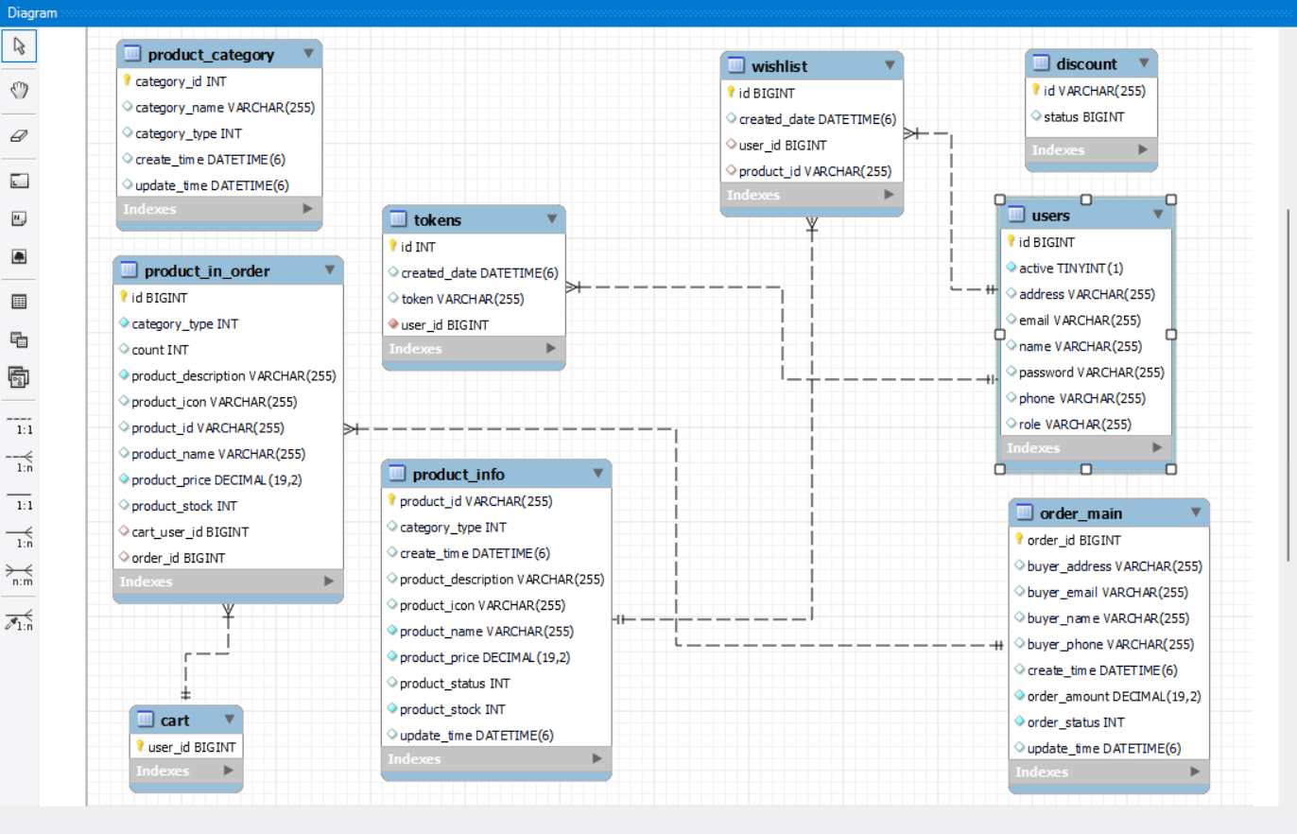
ER Diagram –

Slide 7
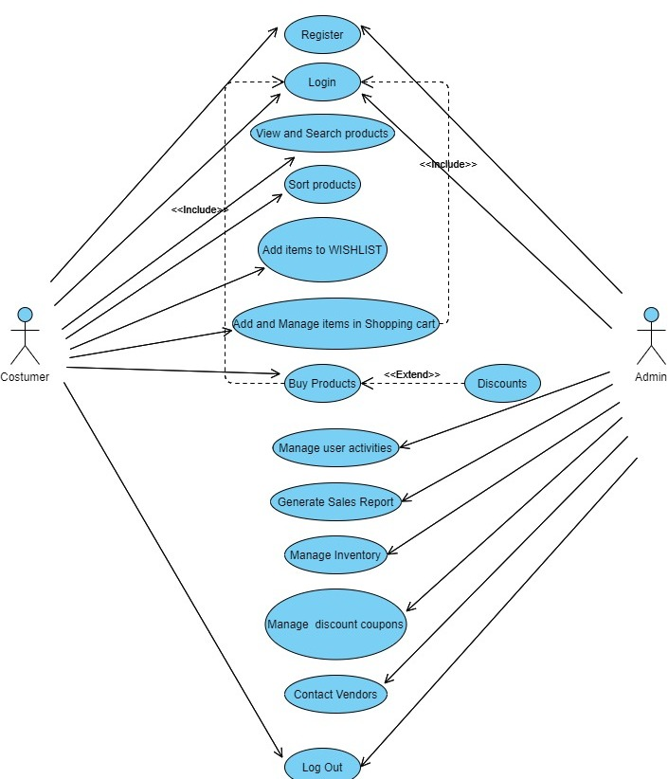
Use Case Diagram –

Slide 8
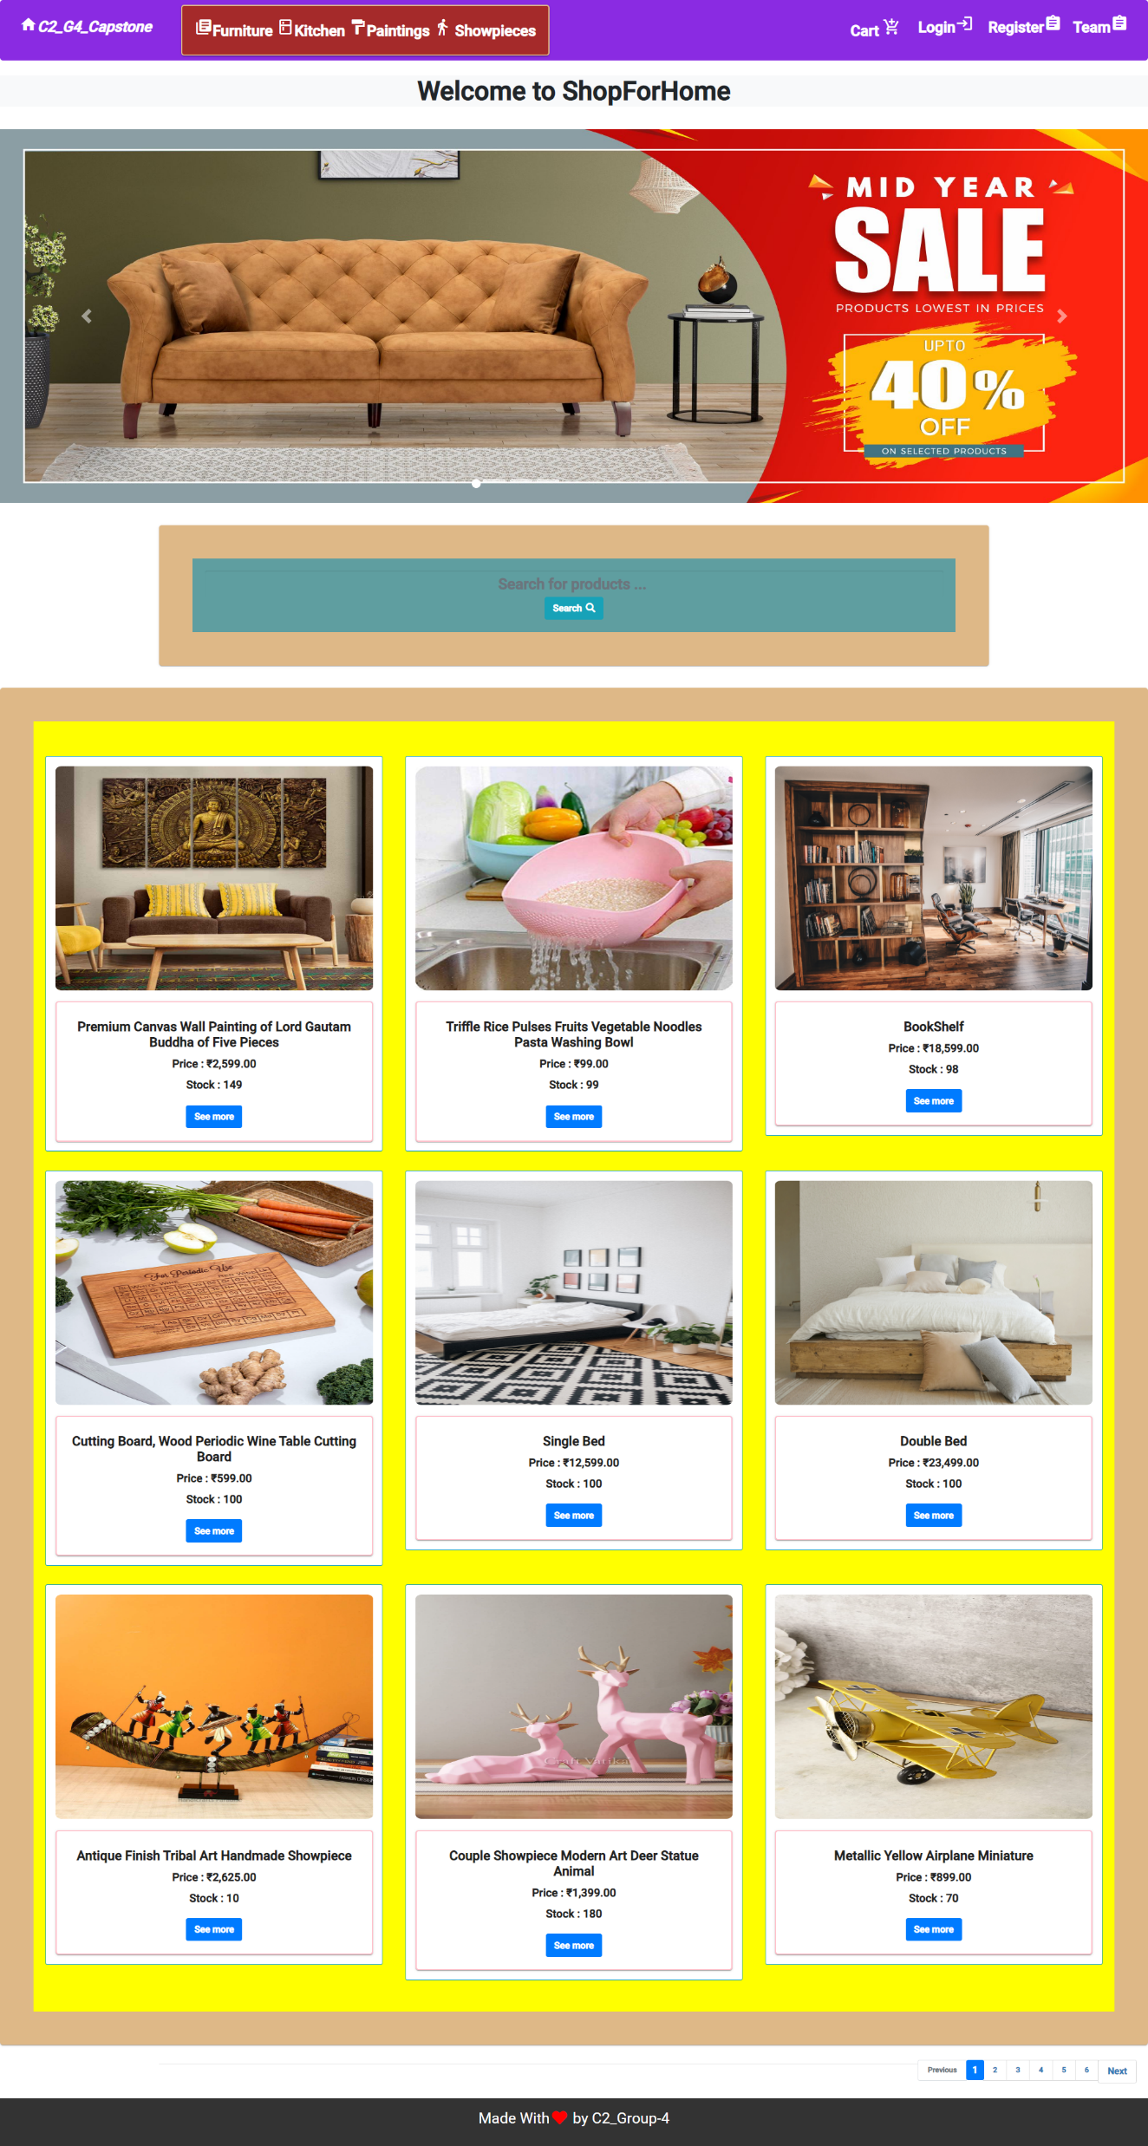
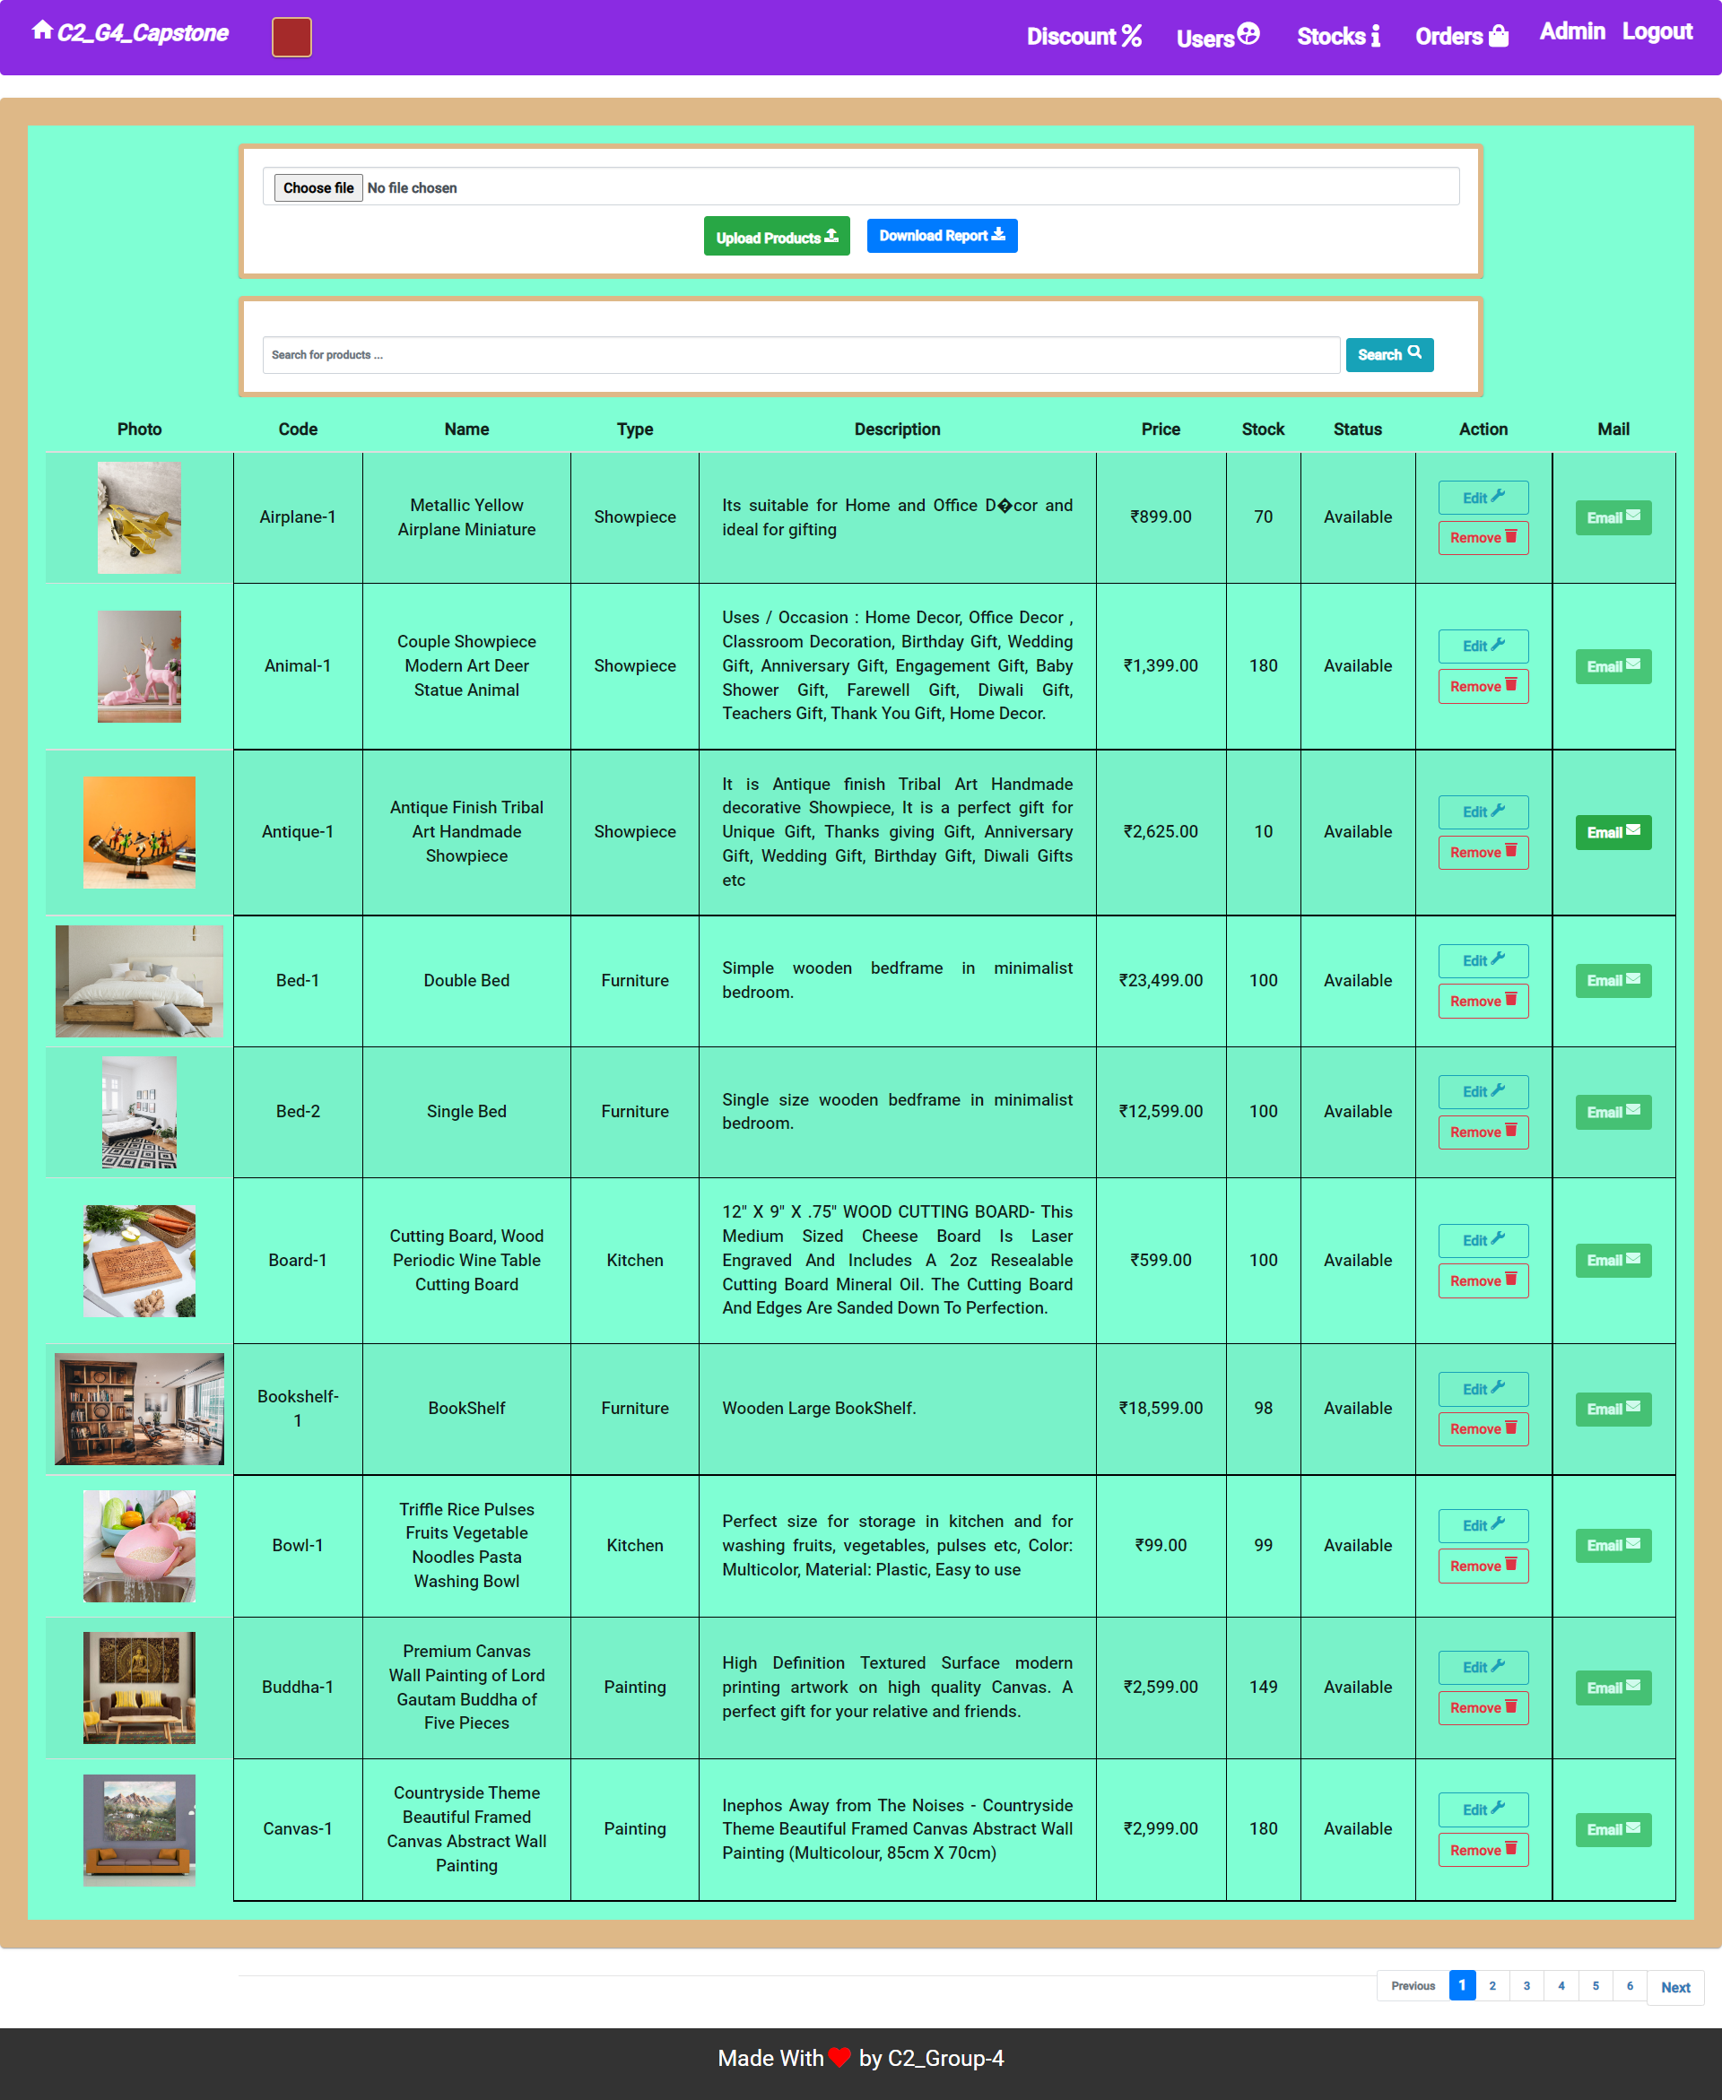
Screenshots of Project -

Slide 9
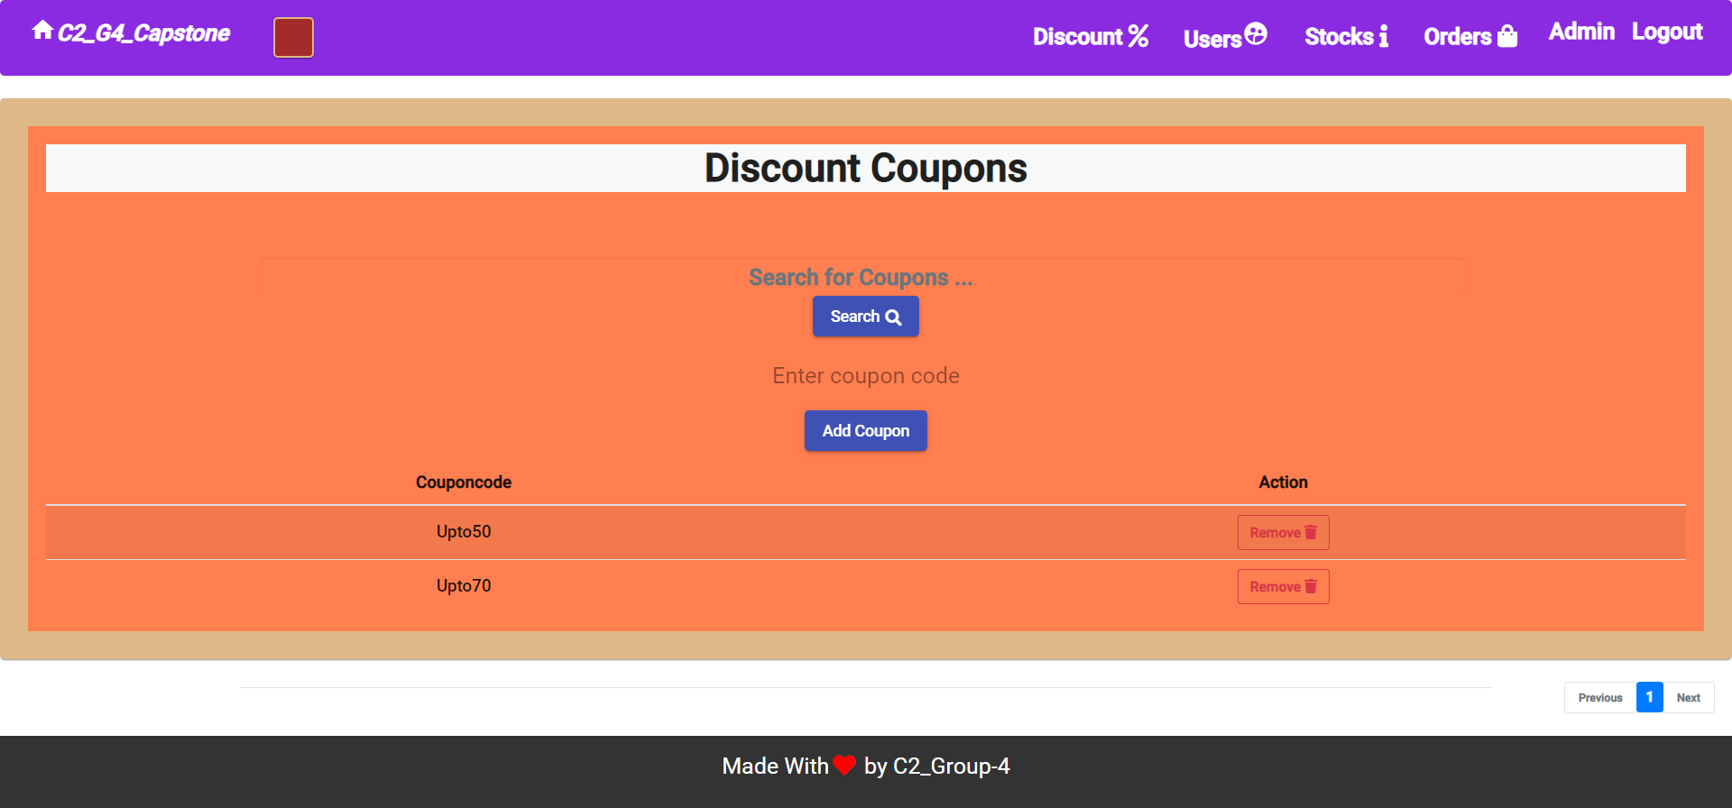
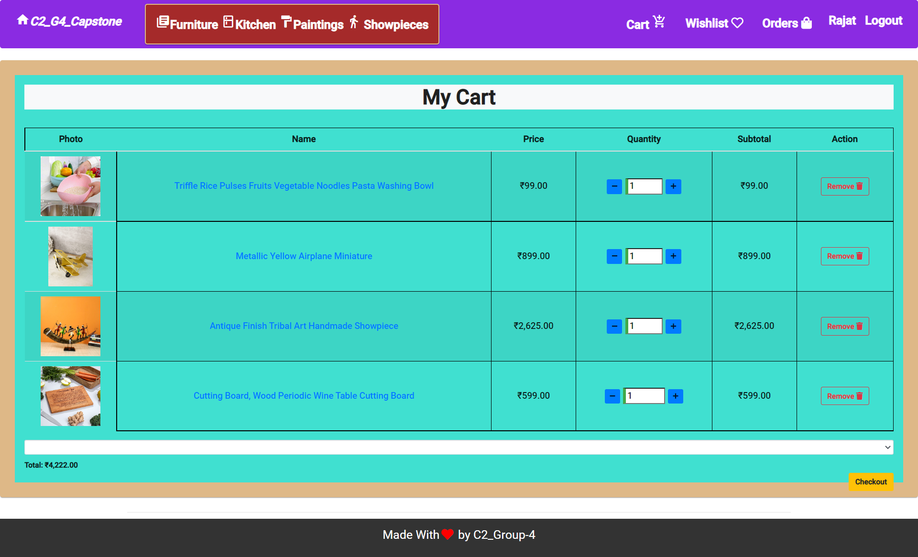

Slide 10

Thank you

